Slide 1
IDENTIFYING new BUSINESS opportunities in GLASGOW
For IBM Data Science Professional Certification

Slide 2
Overview
This project aims to provide data driven insight to businesses by identifying possible business opportunities within Glasgow and the ideal location (postal district) for those business opportunities. The entire project is divided into four stages.
Stage 1 : Post Codes are shortlisted based on whether they are within 5 km of the City Centre and whether they are within 2 km of the nearest Subway station
Stage 2 : The population statistics are extracted from 2 datasets for the shortlisted postal codes
Stage 3 : The venues at each of the shortlisted postal code are found
Stage 4 : An supervised learning algorithm is used to cluster the postal codes based on their similarities to each other.

Slide 3
Data used for this project
Five datasets are used for this project. The datasets come from three sources, namely, webpages, publicly available datasets and the FourSquareAPI.
Dataset 1: All the postal codes in Glasgow with their latitude and longitude information. This dataset comes from webpage [1] and the FourSquareAPI.
Dataset 2: The addresses of the Glasgow Subway stations and the latitude and longitude information. This data comes from a publicly available dataset [2] and the FourSquareAPI.
Dataset 3 and 4: The Royal mail dataset [3] and the Glasgow City Council dataset [4] to extract total population and ethnicity Information. These are publicly available datasets
Dataset 5: The business venues in each postal code This data set is acquired from the FourSquareAPI.
[1] https://en.wikipedia.org/wiki/G_postcode_area [2] https://data.glasgow.gov.uk/dataset/glasgow-subway-station-locations/resource/8c057567-55e7-4631-ae77-e37b4a0562e8 [3] http://www.glasgow.gov.uk/CHttpHandler.ashx?id=16002&p=0 [4] https://data.glasgow.gov.uk/dataset/national-identity-by-ethnic-group-2011-census

Slide 4
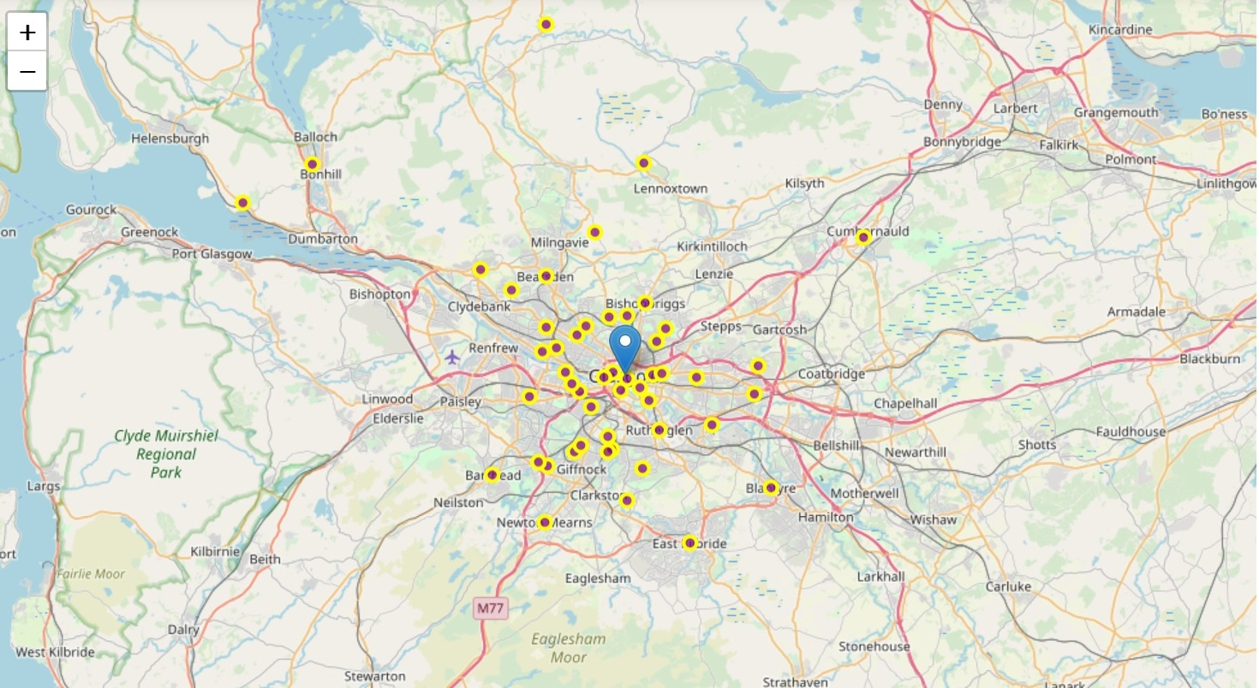
Stage 1 – shortlisting postcodes
Glasgow has a total of 50
non-geographical postal codes
that are spread over a very
large area
Postal codes closer to the
city centre offer more business opportunities

Slide 5
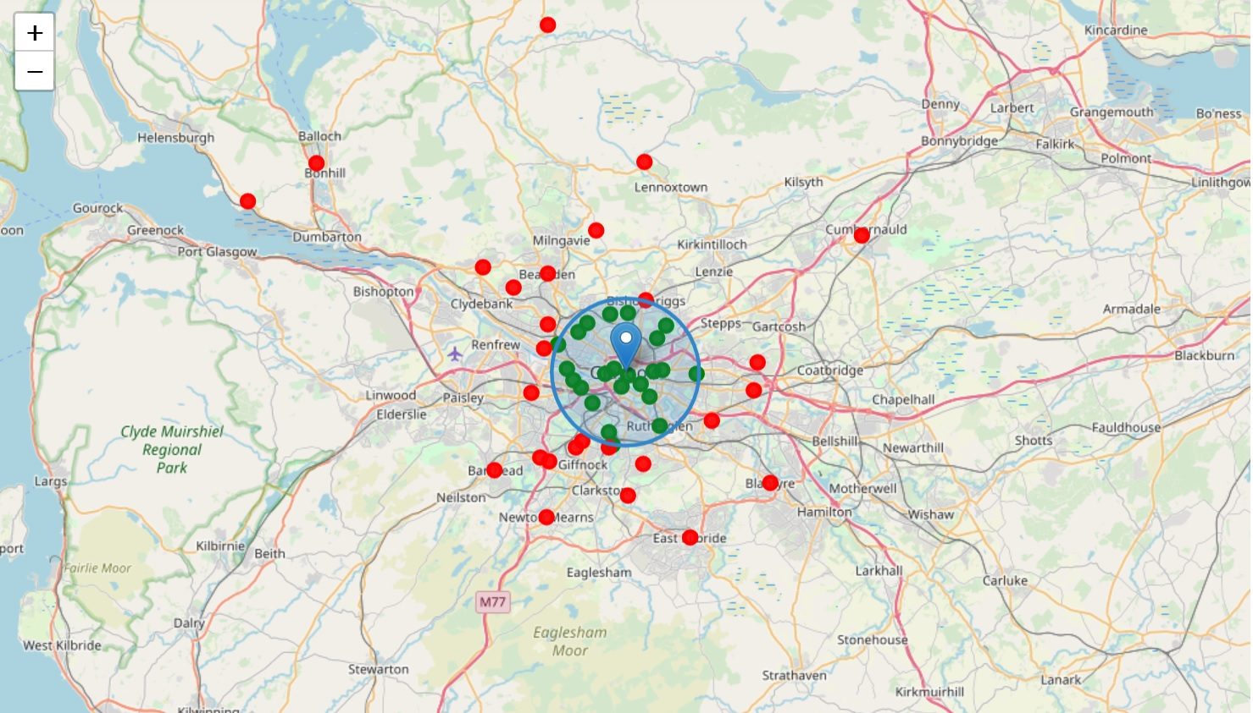
Stage 1 – shortlisting postcodes
Postal codes within 5 km of the city centre are considered suitable for new businesses.
There are only 22 postal codes within 5 km of the city centre.

Slide 6
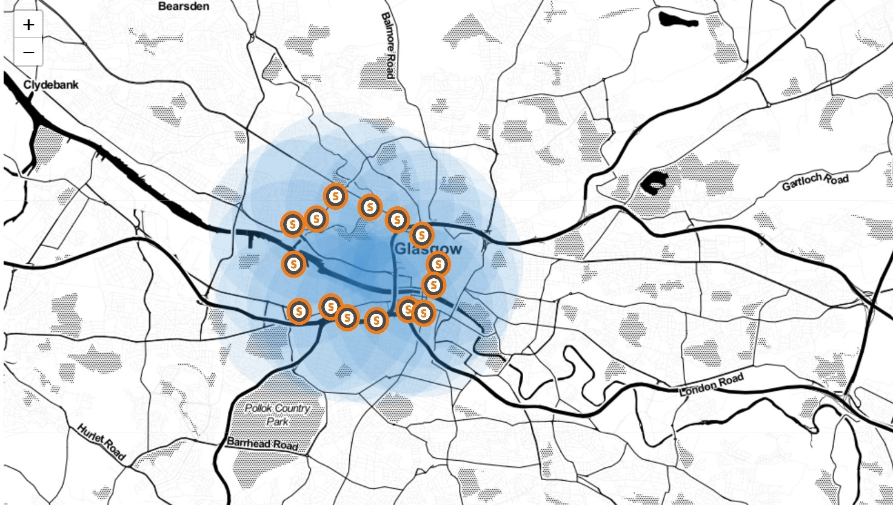
Stage 1 – shortlisting postcodes
Glasgow has 15 subway stations
In the 2018-19 period, 13.1 million subway journeys were recorded
Postal codes within 2 km of the subway stations offer businesses a greater exposure to a wider client base

Slide 7
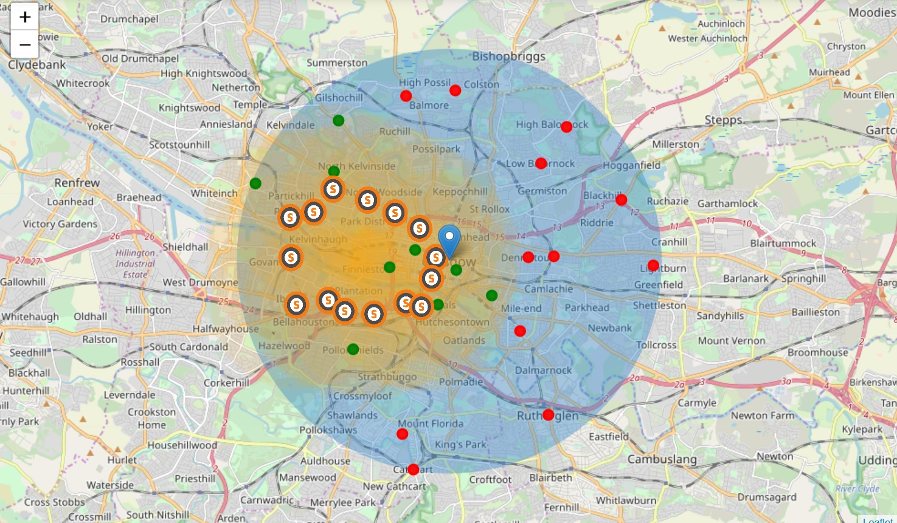
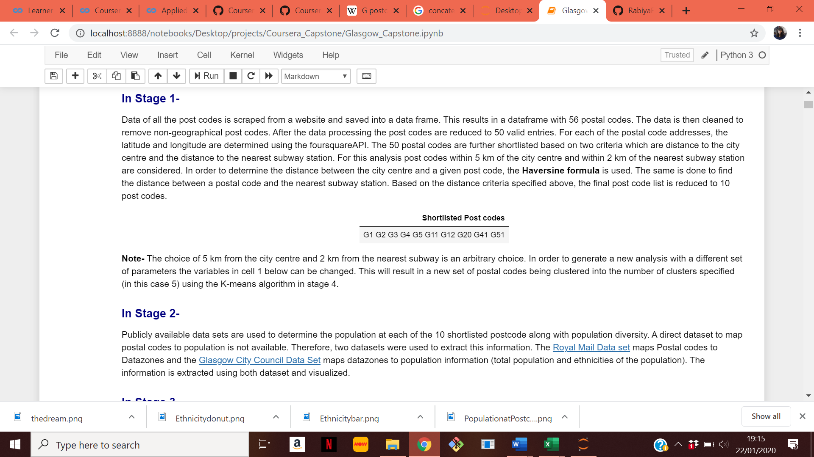
Stage 1 – shortlisting postcodes
There are only ten postal codes that are both within 5 km of the city centre and within 2 km of a subway station

Slide 8
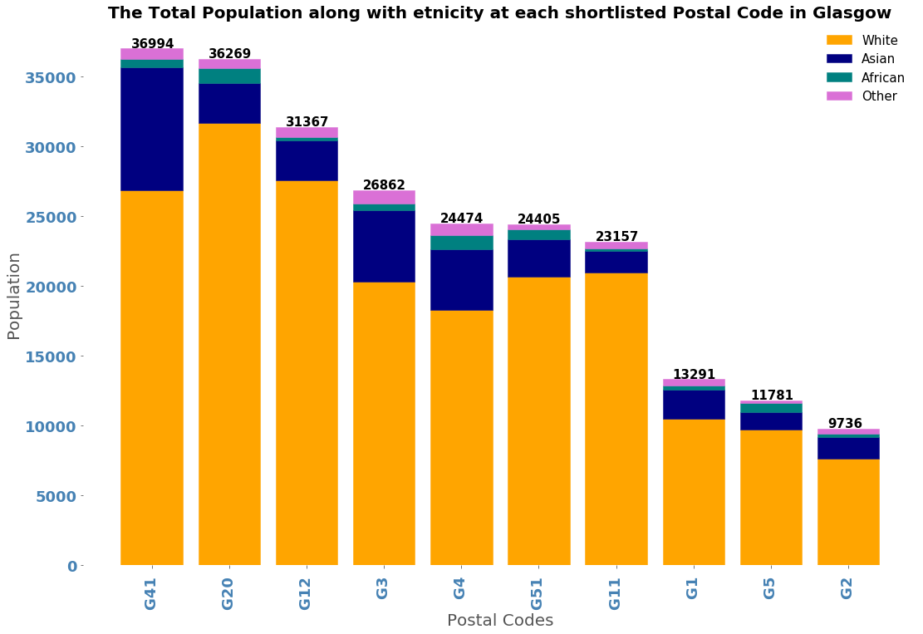
Stage 2 – Extracting population data
A direct dataset that maps postal codes to population is not available. So two datasets are used for this purpose. Dataset 3 is used to map postal codes to data zones. Dataset 4 is used to map data zones to population data.
G41, G20 and G12 have the highest populations.

Slide 9
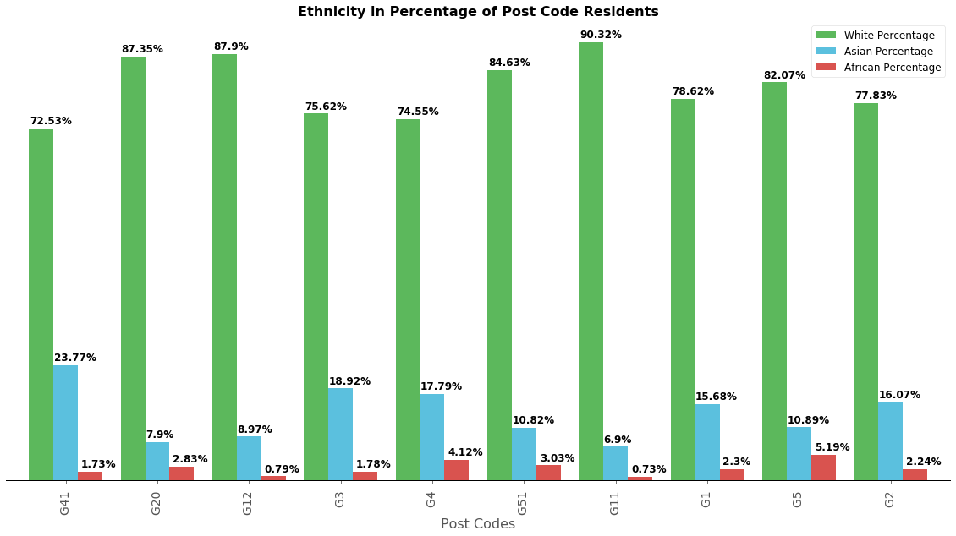
Stage 2 – Extracting population data
G11 has the highest percentage of population with White Ethnicity
G41 has the highest percentage of population with Asian Ethnicity
G5 has the highest percentage of population with African Ethnicity

Slide 10
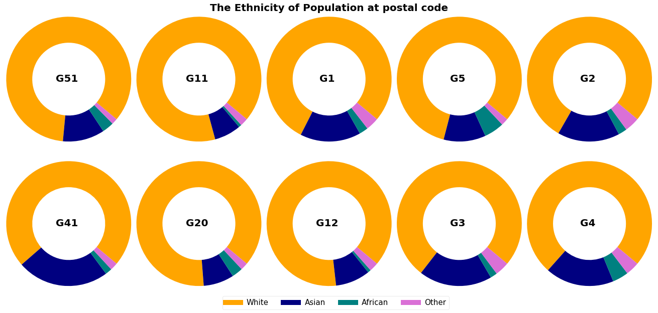
Stage 2 – Extracting population data
G1 and G2 have similar population make-up
G11 and G12 also have similar population make-up

Slide 11
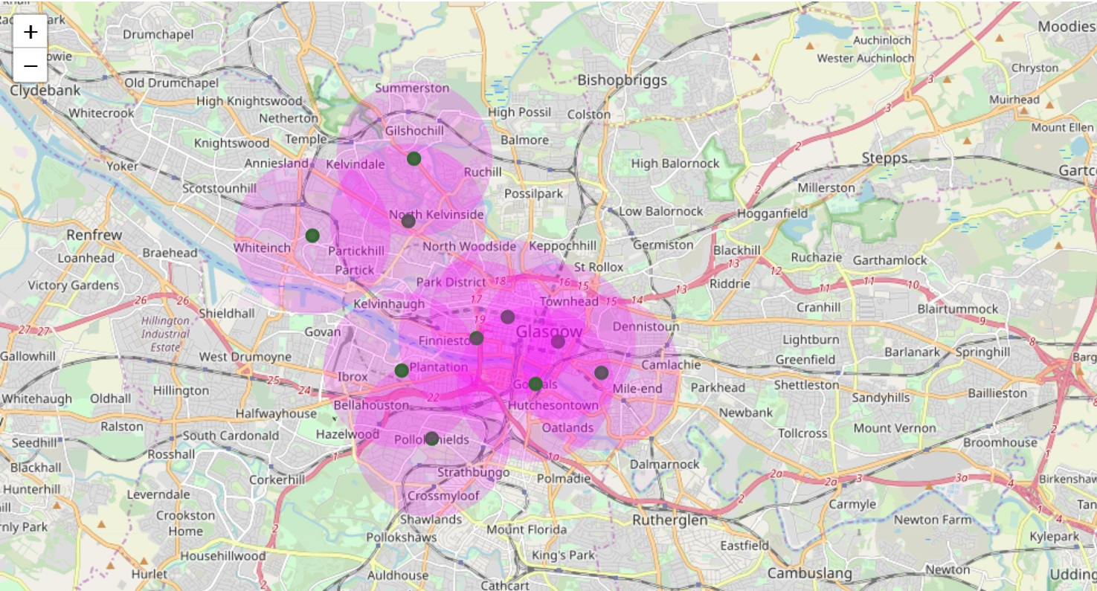
STAGE 3- EXTRACTING VENUES
Venues within 1.5 km of each postal codes are retrieved from the FourSquareAPI.
The API returns 786 venues
Venues belong to neighbouring postal codes and repeating venues are removed
There are 420 unique business venues within the 10 postal codes

Slide 12
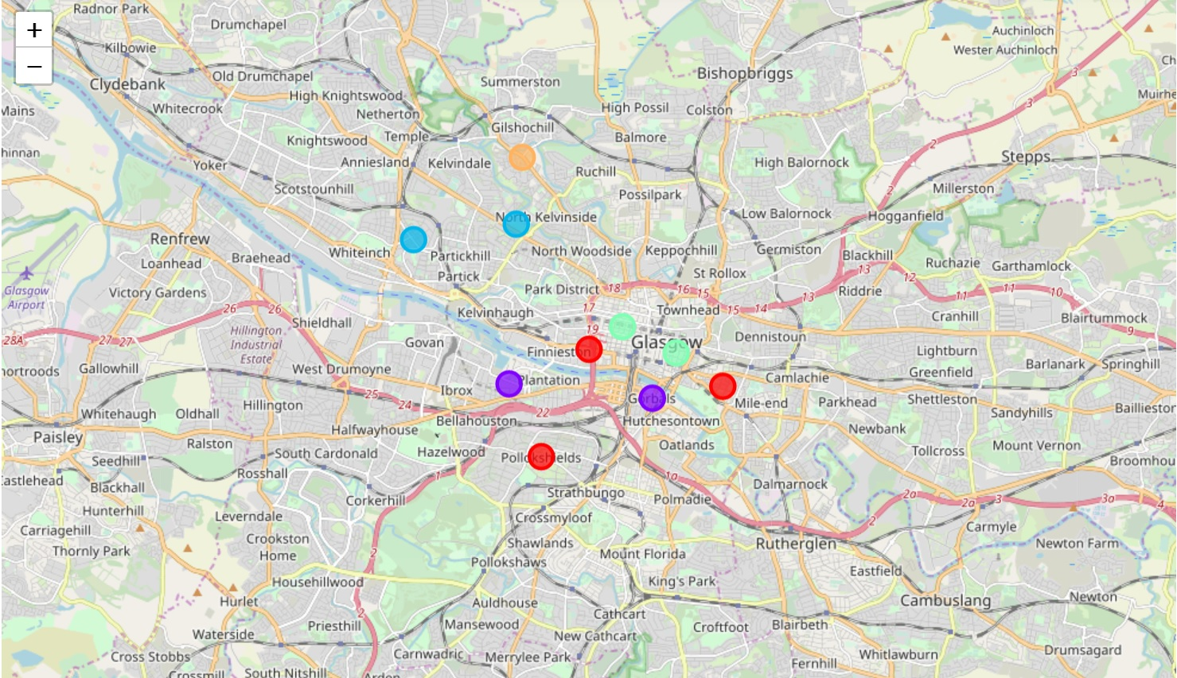
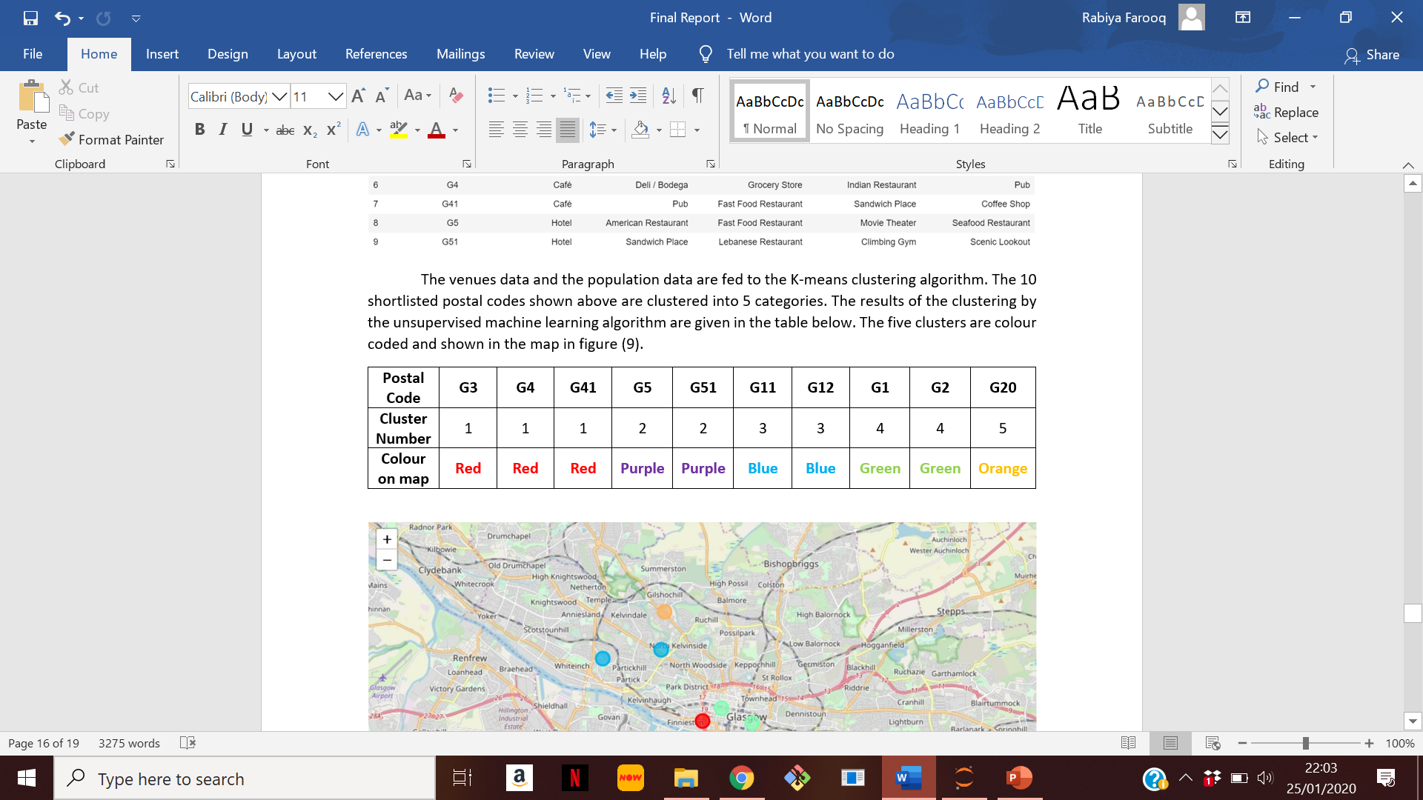
STAGE 4- CLUSTERING OF POSTAL CODES
The venues data and the population data are fed into K-means algorithm.
The 10 postal codes are clustered into 5 categories.

Slide 13
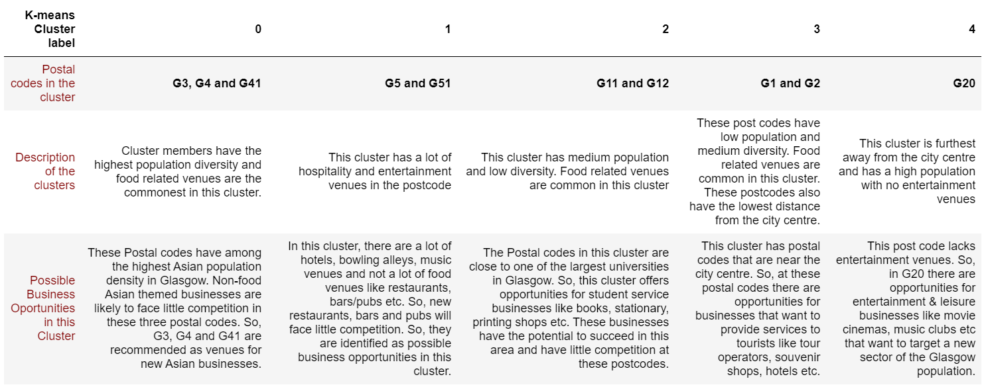
Results of clustering and possible business opportunities SUMMARY

